Slide 1
Welcome to FeatureCAM 2007 Training
Introduction to FeatureCAM 2007

Slide 2
FeatureCAM
Delcam USA

Slide 3
Agenda
Session 1
1. Instructor Introduction
2. Web Interface
3. Class Introduction
4. User Interface Introduction
5. Demonstration
Session 2
1. Part Types
2. Stock
3. Save your work

Slide 4
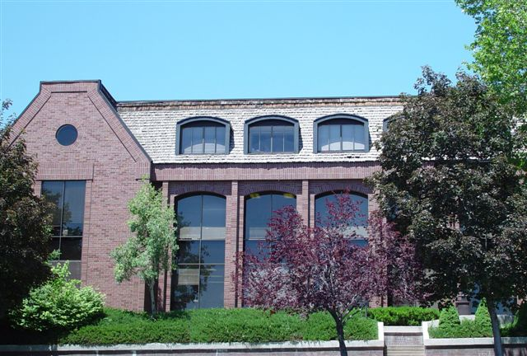
Delcam USA Corporate Mission
To provide innovative, quality solutions and world-class customer support as the market leader in computer-aided manufacturing (CAM) software
Corporate Headquarters – Salt Lake City, Utah

Slide 5
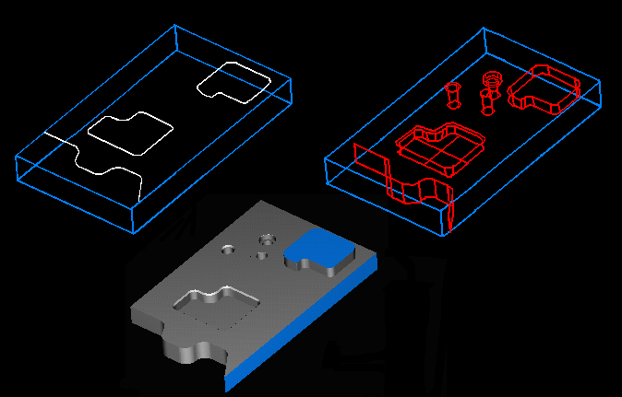
What is a Feature?
Instead of Programming Parts One Operation at a Time, FeatureCAM Defines Parts With Features – Common Shop Terms Such as a Hole, Groove, Pocket, Boss, Side or Face. A Feature is made up of one or more associative operations.

Slide 6
Comparison Operation-based
FeatureCAM
Feature-based
Traditional CAM Software
Operation-based
1. Draw or Import Your Part
2. Identify Features
3. Click Simulation
You Are Done!
1. Draw or Import Your Part
2. Select a Rough Operation
3. Select Rough Boundary
4. Select a Type of Toolpath
5. Select a Roughing Tool
6. Select Feeds and Speeds
7. Select Stepover & Z Steps
8. Select a Finish Operation
9. Select Finish Boundary
10. Select a Type of Toolpath
11. Select a Finishing Tool
12. Select Stepover & Z Steps
13. Select Feeds & Speeds
14. Click on Simulation
FeatureCAM Automatically:
Determines Rough and Finish Operations
Selects ALL Tools Sizes
Calculates Feeds & Speeds
Determines Stepover & Z Increments
Generates Toolpath
Creates NC Code

Slide 7
Comparison Process-based
FeatureCAM
True Feature-based
1. Draw or Import Your Part
2. Identify Features
3. Click Simulation
You Are Done!
FeatureCAM Automatically:
Determines Rough and Finish Operations
Selects ALL Tools Sizes
Calculates Feeds & Speeds
Determines Stepover & Z Increments
Generates Toolpath
Creates NC Code
IMITATION Feature-based
Processed-based
1. Draw or Import Your Part
2. Identify Features
3. Select Machining Processes
4. Click Simulation
Are You Done?
You Must Analyze and Verify:
If the Process has the Correct Operations?
If the Process has the Correct Size Tools?
If the Process has the Correct Feed & Speeds?
If the Process has the Correct Stepover & Z Increments?

Slide 8
What Makes FeatureCAM Easy to Use?
Feature-based Manufacturing
User Friendly Interface (Steps & Wizards)
Automatic Tool Selection (2D & 3D)
Automatic FeatureRECOGNITION
Standard Databases (Tools, Materials, Feeds & Speeds)
Customizable Post Processors
Outstanding Technical Support

Slide 9
Purpose of FeatureCAM
Simple, Effective, Automatic
To make the code that runs your machines. That is FeatureCAM’s purpose
Automatic or Auto-“Magic”
FeatureCAM has the unique ability to generate code to run our machines with a minimum amount of input. This “intelligence” can be customized so that FeatureCAM will make the programming choices that you would make if programming by hand.
We all have our own style of cutting and it makes no sense to have to set every single detail every time we create an operation.

Slide 10
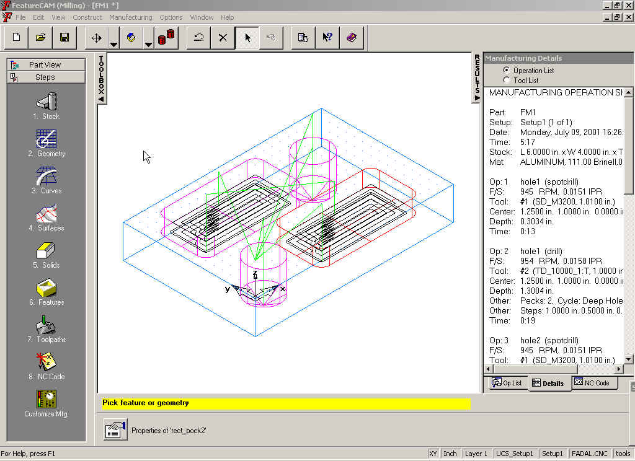
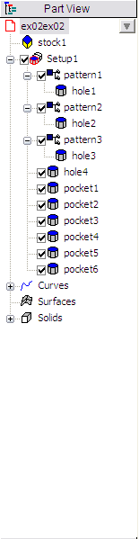
User Interface
Menu Bar
Toolbar
Part View
Toolbox
Manufacturing
Results Window
Steps
Toolbox
Geometry
Dialog Bar
Assistance Bar
Status Bar
Graphics Window
Notes:
FeatureCAM is a windows-based product with a menu bar and toolbar at the top of the screen.
The basic interface has three different sections
On the left is the Steps toolbar. You can access most of the program from these buttons. (If you are demonstrating the program, we recommend that you use the steps instead of toolbar buttons to keep the interface simple.)
Under the Steps Toolbar is the Part View Tool Box. This contains the names of the objects you are creating on the screen.
In the middle of the screen is the Graphics window. All drawings and toolpath simulations happen in this window.
On the right is the Manufacturing Results Window. The automatically generated documentation and part programs are shown in this window.
At the bottom of the screen are the assistance, geometry and status bars. The assistance bar is where you are prompted while creating geometry.
The Geometry dialog bar is where you enter parameters for 2D geometry.
The status bar contains the current state of the program.

Slide 11
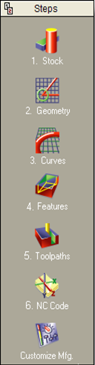
Steps
Step 1 - Stock. The Stock Wizard steps you through entering the shape and dimensions of the stock, the stock material, part program zero and the coordinate system for modeling.
Step 2 – Geometry. Points, arcs, lines and other shapes are used to describe the overall shape of parts. Many different geometry tools are available. Geometry can also be imported from CAD systems.
Step 3 – Curves. Shapes that involve more than a single line or arc are described as curves. For FeatureMILL3D customers there is also a Surfaces step for creating 3D surfaces.
Step 4 – Features. Features are common shop terms like pocket, or thread. They are created from curves and dimensions. These objects describe your part in 3D and are used to generate toolpaths.
Step 5 – Toolpaths. Toolpaths are generated from collections of features. You can simulate them in FeatureCAM using toolpath centerlines, 2D shaded or 3D solid shaded simulations.
Step 6 – NC Code. Machine-specific G-codes are generated from the toolpaths. Translators are provided for many different NC controls and include a program for creating new translators.
Customize Manufacturing. FeatureCAM automates the entire part programming process, you can customize all of the system settings including feed/speed tables, tooling databases or feature settings.

Slide 12
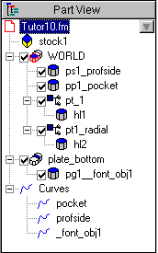
Part View Toolbox
Left-click selects the object in the graphics window
Right-click reveals menu of options
Click on a “+” to expand the view to reveal objects that are subordinate
Notes:
(Open any sample 2D milling part in the examples directory)
Click on the Part View under the Steps Toolbox.
This is a list of the objects that are included in your part.
(Click on one of the features and show how the object is highlighted)

Slide 13
Part View Icons
Part icon represents the entire part. The part file name is also displayed in the tree view.
Stock icon represents the part stock.
Setup icon represents a setup. The features of a setup are listed underneath a setup.
Feature icon represents features. The checkbox next to the feature can be used to exclude it
from toolpath generation. The feature is not deleted; it is just ignored for toolpath generation.
Curve icon represents a curve in the part model.
Surface icon represents surfaces. Surface milling features are classified as features, not surfaces.
Solid icon represents a solid. Individual design features are listed underneath.
Turret icon represents a turret on a lathe. Selecting a specific turret displays the NC code.
Notes:
(This slide explains what all of the icons are in the part view. Just read through the slide)

Slide 14
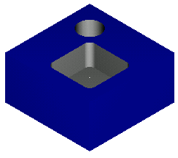
Create Your First Part
Create this part quickly using FeatureCAM’s automation
Introduce you to:
  Features
  Toolpath simulation
  Automation
  Documentation

Slide 15
Minimum Input, Maximum Code
Instructor led exercise
1. Start a new file
2. Milling Setup in Inches
3. 4X4X1 Stock, finish
4. Hole Feature, next, Dimensions Plain hole .5Dia.x 1 Deep Through Checked. Next, Location 3x, 3Y, 0Z, finish
5. Rectangular Pocket Feature, next, Dimensions 2x2x.5, next,
6. Location .5X, .5Y, 0Z, finish
7. Toolpaths, Centerline Sim., 2D Sim., Isometric 3D sim.
8. Results – Operations, tools, Feeds & Speeds, Depth, Details, NC Code

Slide 16
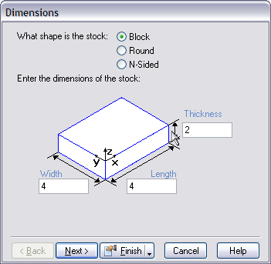
Stock
Start FeatureCAM from the Start menu
Select New File
Select Milling Setup and Inch and click Finish
Select Block
  Width 4
  Length 4
  Thickness 2
Click Finish

Slide 17
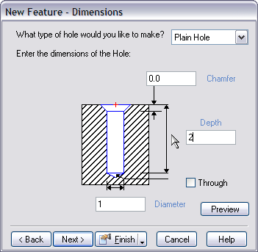

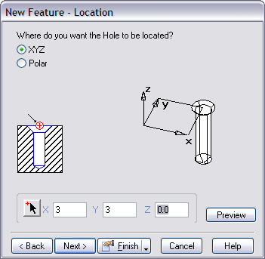
Create a Hole
Click Features step
Select Hole, click Next
  Diameter 1
  Depth 2
Click Next
Location
  X 3
  Y 3
  Z 0
Click Finish

Slide 18
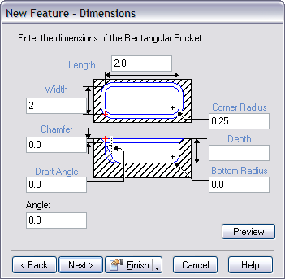
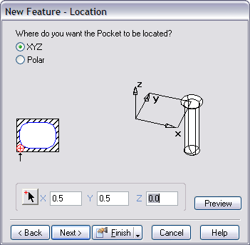
Create a Rectangular Pocket
Click Features step
Select Rectangular Pocket
  Length 2
  Width 2
  Depth 1
  Corner Radius 0.25
Click Next
Location
  X 0.5
  Y 0.5
Click Finish

Slide 19
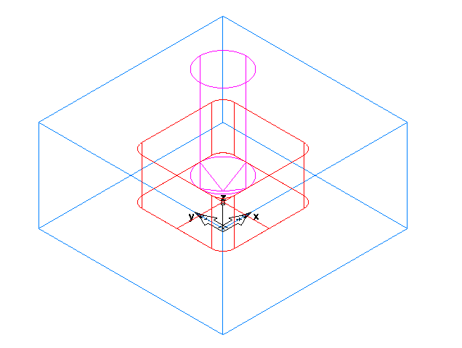

Viewing and Saving
Click the Isometric view button
Select Save from the File menu and call the part firstpart.fm

Slide 20


Simulating Toolpaths
Select Toolpath step
  Simulation toolbar is displayed
Click on Simulation Type
Click Play button
Use Speed Control to slow down
Fast Forward to End
Region of Interest
Machine
Center Line
2D
Rapid
Cut
Next
Flyout.
3D
Stop
Single
Step
Tool
Load
Play
Clear
Eject Button
Simulation Type
Simulation Controls
Speed Control

Slide 21
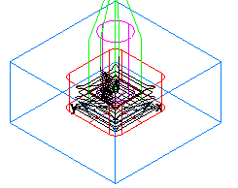
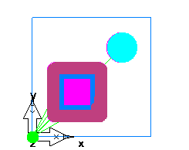

Simulate the Toolpaths
Click Centerline and Play
Click 2D and Play
Click 3D and Play
Click Rapid Cut and Play

Slide 22
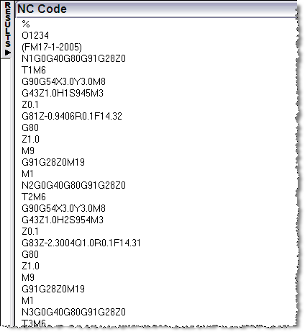

Documentation
Click on the Op List tab in the Manufacturing Results Window
Click on the Details tab
Click on the NC tab

Slide 23
Feature Types
From Dimensions
From Curve
From Feature
Surface Milling

Slide 24
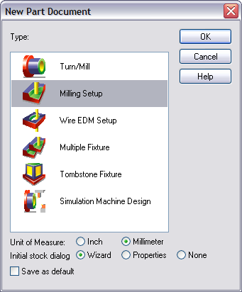
FeatureCAM Part Types
Part Types
- depends on
what you
have licensed)
Notes:
Turn or Turn/mill – 2D turning document (FeatureTURN) or a document for milling and turning on the same machine (FeatureTURN/MILL)
Milling – 2D milling (FeatureMILL) or 3D milling (FeatureMILL3D)
WireEDM – FeatureWIRE
Multiple Fixture – Cut multiple milling documents in a single vise or multiple vises. This functionality is included in FeatureMILL.
Tombstone – A separate option for cutting multiple milled parts on a horizontal or vertical indexer.
Simulation machine design – interface for annotating a solid model of a machine. This model will later be used for simulating the machine during 3D toolpath simulation.

Slide 25
Stock
Part programming starts with stock model
Stock controls extent of cuts
Used for 3D toolpath simulation

Slide 26
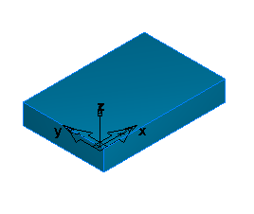
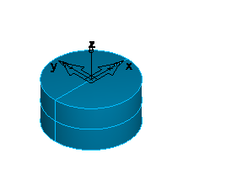
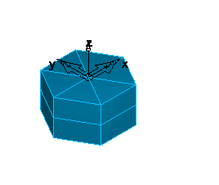
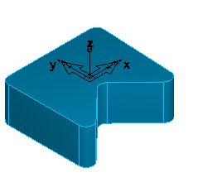
Stock types
Block
Round
N-sided
User Defined

Slide 27
Stock wizard pages
Material
  Used for feed/speed calculation
  Must also enter hardness
Multi-axis positioning
  4th or 5th axis indexing
Setup
  Fixture offset & part program name
Program zero
Machine simulation file
Notes:
Use context sensitive help for more in-depth information on any page.

Slide 28
Saving you Work
Save the FeatureCAM file:
Use the File pull down menu and choose Save As to rename your file or save it for the first time.
Choose Save to update your existing file
This file is not the code that runs your machine, it is the native FeatureCAM file.
Save the Code to your machine:
Use the File pull down menu and Choose Save NC
Click the NC Code Step

Slide 29
Course Review
Introduction to Feature-based machining
Created our first part
Introduction to
  User interface
  Creating a new part
  Specifying the stock
  Saving a part

Slide 30
Questions?

